Slide 1
Individual homework Boolean functions
Veitch-Karnaugh Diagrams Method
Made by Turcu Ciprian-Stelian

Slide 2
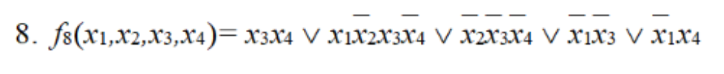
Problem statement
Exercise 4.
Simplify the following Boolean functions of 4 variables using Veitch diagrams

Slide 3
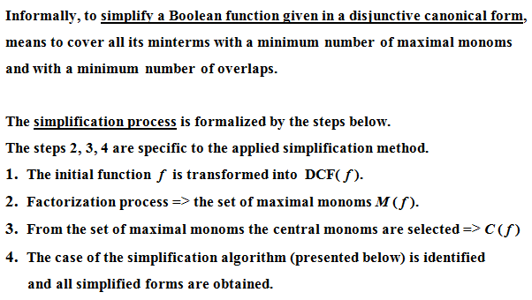
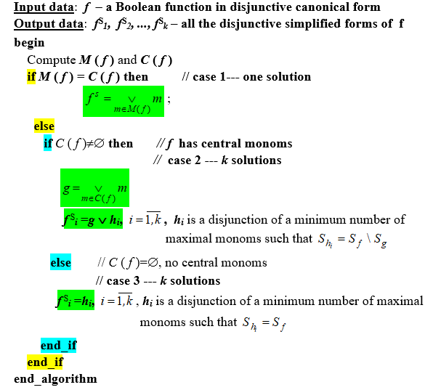
Theoretical result

Slide 4
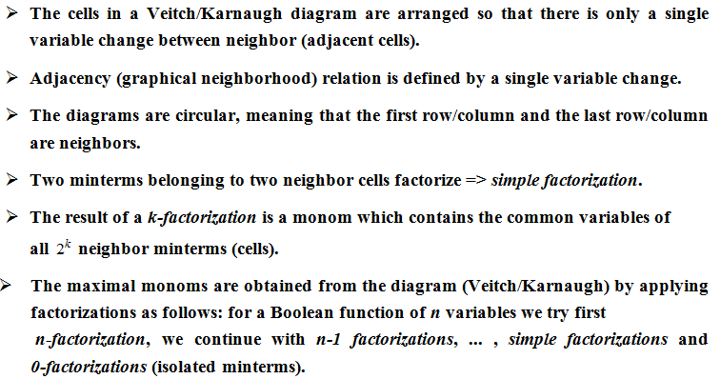
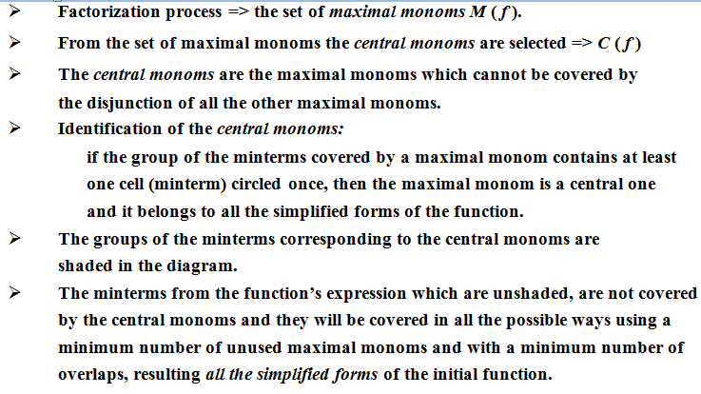
Veitch-Karnaugh Diagrams Method

Slide 5
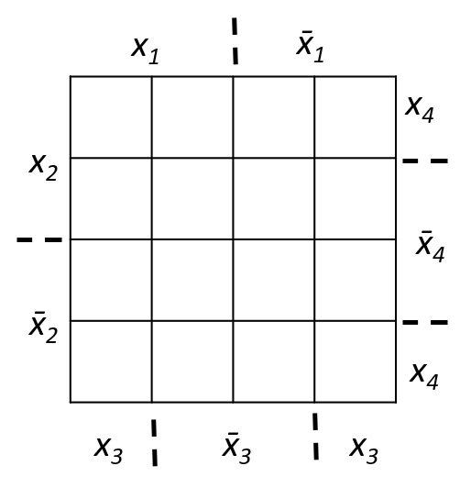
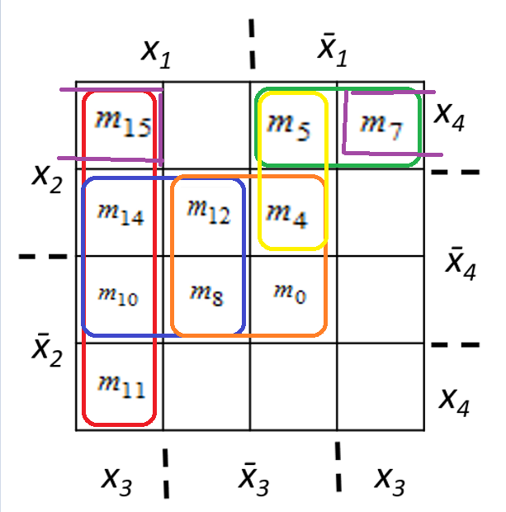










7. f7(x1,x2,x3,x4)=x̅3x̅4 V x̅1x2x̅3x4 V x2x3x4 V x1x3 V x1x̅4 = x1x2x̅3x̅4 V x̅1x2x̅3x̅4 V x1x̅2x̅3x̅4 V x̅1x̅2x̅3x̅4 V x̅1x2x̅3x4 V x̅1x2x3x4 V x1x2x3x4 V x1x̅2x3x̅4 V x1x̅2x3x4 V x1x2x3x̅4 =m12 V m4 V m8 V m0 V m5 V m7 V m15 V m11 V m10 V m14
Veitch Diagram
Factorization process

Slide 6
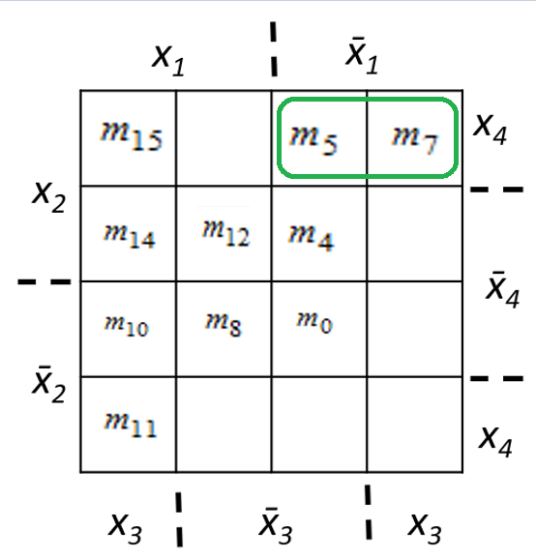
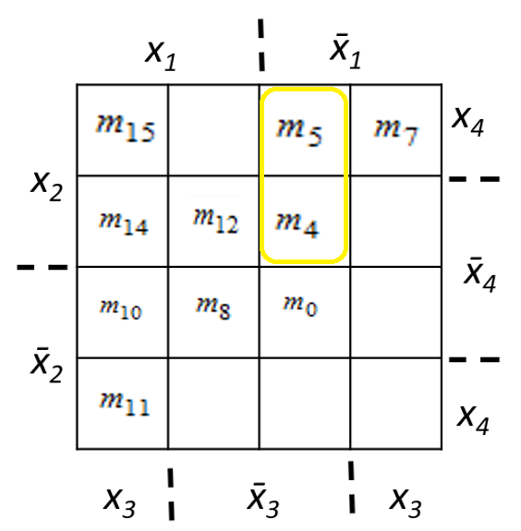
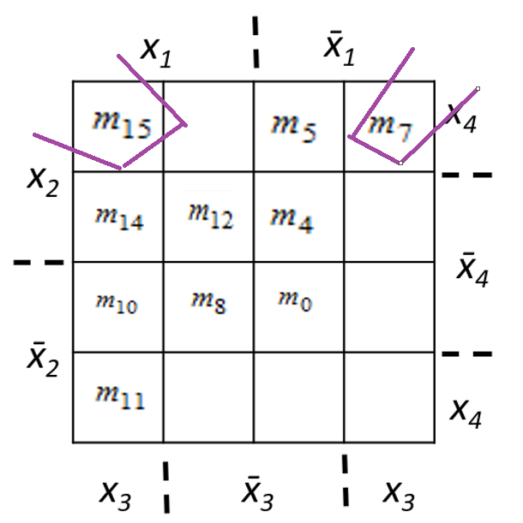
Factorization process
-simple factorization-
Maximal monom: max1 = x̅1x2x4
Maximal monom: max2 = x̅1x2x3
Maximal monom: max3 = x2x3x4

Slide 7
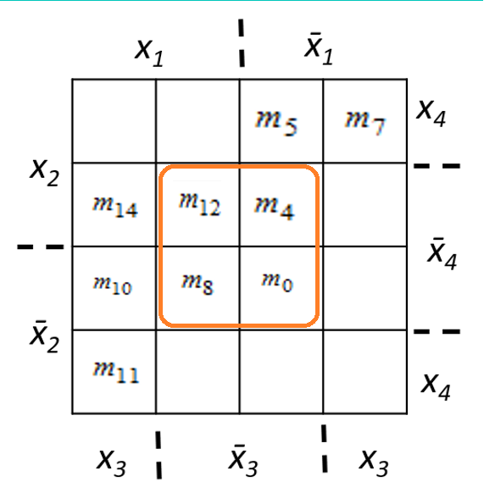
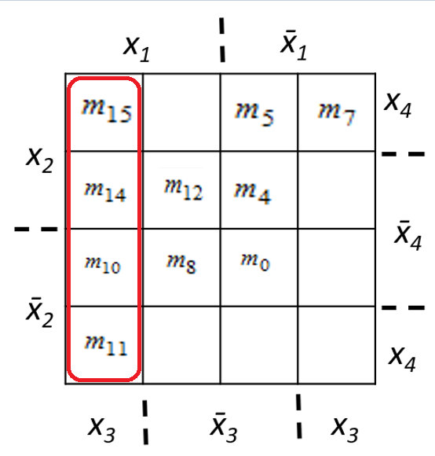
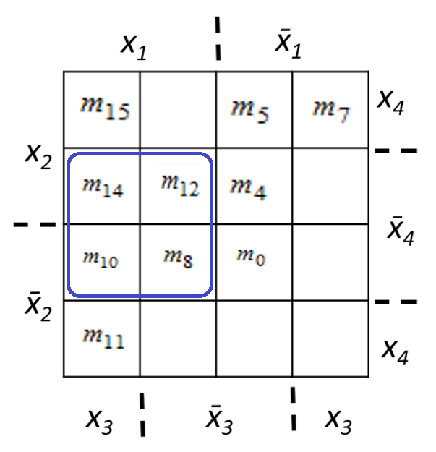
Factorization process
-double factorization-
Maximal monom: max4 = x̅3x̅4
Maximal monom: max5 = x1x3
Maximal monom: max6 = x1x̅4
The set of maximal monoms:
M(f)={max1,max2,max3,max4,max5,max6}
={x̅1x2x4, x̅1x2x3, x2x3x4, x̅3x̅4, x1x3, x1x̅4}

Slide 8
Central monoms
A maximal monom is a central monom if its corresponding group of minterms contains at least one minterm circled once.
M(f)={max1,max2,max3,max4,max5,max6}
C(f)= {max4,max5}
M(f) ≠ C(f) and C(f) ≠ ø – the second case of simplification.
We denote by g = max4 V max5 = x̅3x̅4 V x1x3
The minterms covered by g are circled with orange.
m5, m7 are not covered by the cental monom and we can cover them in 3 ways
f 1^{S}(x₁x₂x₃x₄) = g V max1 = x̅3x̅4 V x1x3 V x̅1x2x4
f 2^{S}(x₁x₂x₃x₄) = g V max2 V max3 = x̅3x̅4 V x1x3 V x̅1x2x3 V x2x3x4

Slide 9
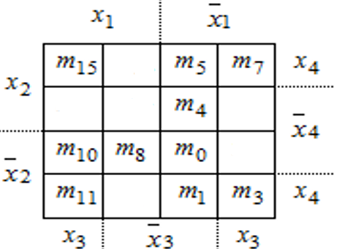
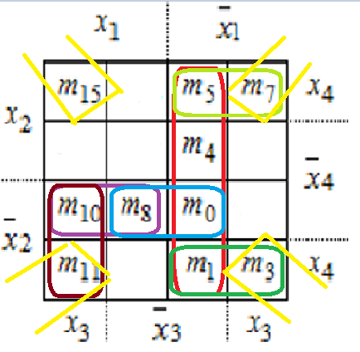
8.f8(x1,x2,x3,x4)=x3x4 V x1x̅2x3x̅4 V x̅̅2x̅3x̅4 V x̅1x̅3 V x̅1x4 = x1x2x3x4 V x̅1x̅2x3x4 V x̅1x2x3x4 V x1x̅2x3x4 V x1x̅2x3x̅4 V x1x̅2x̅3x̅4 V x̅1x̅2x̅3x̅4 V x̅1x2x̅3x4 V x̅1x̅2x̅3x4 V x̅1x2x̅3x̅4 = m15 V m3 V m7 V m11 V m10 V m8 V m0 V m5 V m1 V m4
Veitch Diagram
Factorization process

Slide 10
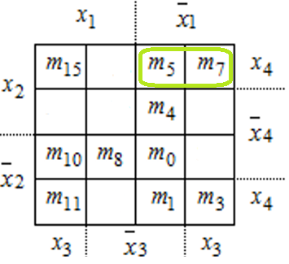
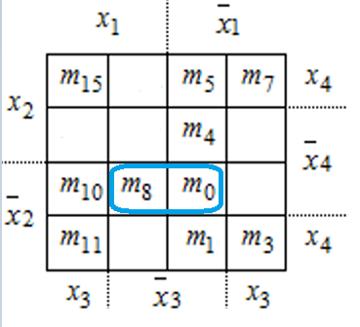
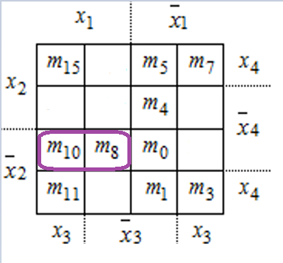
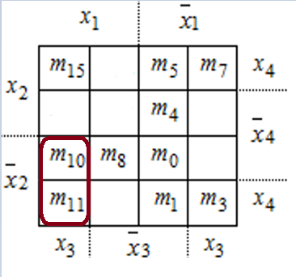
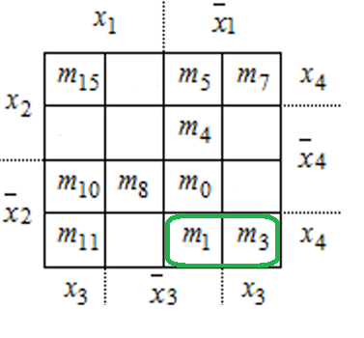
Factorization process
-simple factorization-
Maximal monom: max1 = x̅1x2x4
Maximal monom: max2 = x̅2x̅3x̅4
Maximal monom: max3 = x1x̅2x̅4
Maximal monom: max4 = x1x̅2x3
Maximal monom: max5 = x̅1x̅2x4

Slide 11
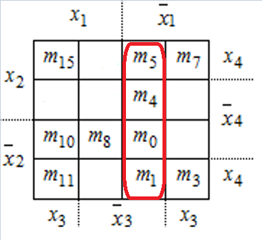
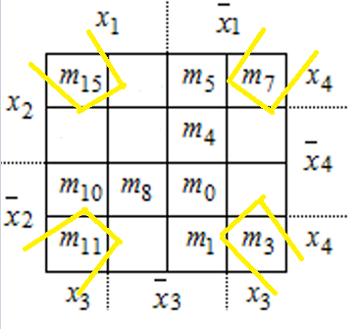
Factorization process
-double factorization-
Maximal monom: max6 = x̅1x̅3
Maximal monom: max7 = x3x4
The set of maximal monoms:
M(f)={max1,max2,max3,max4,max5,max6,max7}
={x̅1x2x4, x̅2x̅3x̅4, x1x̅2x̅4, x1x̅2x3, x̅1x̅2x4, x̅1x̅3, x3x4}

Slide 12
Central monoms
A maximal monom is a central monom if its corresponding group of minterms contains at least one minterm circled once.
M(f)={max1,max2,max3,max4,max5,max6,max7}
C(f)= {max6, max7}
M(f) ≠ C(f) and C(f) ≠ ø – the second case of simplification.
We denote by g = max6 V max7
The minterms covered by g are circled with red and yellow.
M10, m8 are not covered by the cental monoms and we can cover them in x ways
f 1^{S}(x₁x₂x₃x₄) = g V max3 = x̅1x̅3 V x3x4 V x1x̅2x̅4
f 2^{S}(x₁x₂x₃x₄) = g V max4 V max2 = x̅1x̅3 V x3x4 V x1x̅2x3 V x̅2x̅3x̅4

